Slide 1




Data Collection & Hub Metrics
CSOs Training
22nd February, 2023

Slide 2

Data?
Raw facts and figures collected for reference and analysis

Slide 3
Our Data Philosophy
Our Commitment:
Listen and respond to what communities & systems tell us. Sharing the good, bad and ugly about what we learn.
Goal: Iteratively improve the quality of services we offer.
How can we measure and understand impact?
    Ongoing assessment of usage at the Hubs based on analysis of
    *internet searches
    *applications usage
    *energy consumption
    *other hub activity(programs/training)
    Qualitative and quantitative survey data from hub users

Slide 4


Your Data Tools
Tool
Data
MoUs
Registers
Scanned docs
Contracts
Hub monitoring forms
Photo/Video consent forms
Programs data
Notes:
Need for a smartphone!

Slide 5
ODK & Ona
User Manual is available
Setup and Configuration
  Ona username and password
  ODK app download and installation
  Add project details
  Get forms
  Fill forms
  Send/submit form
  Form updates

Slide 6
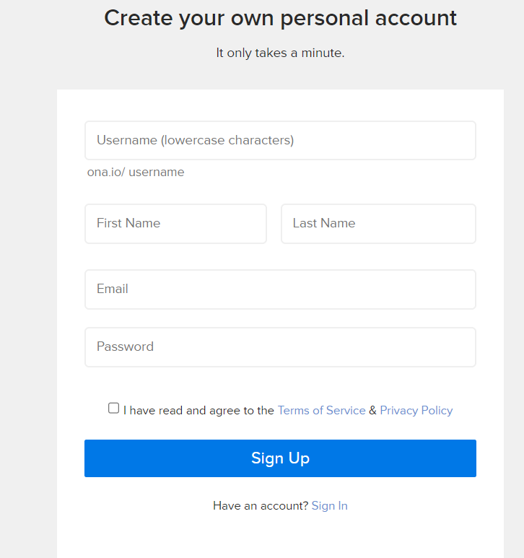
Ona username and password
Create the account at
https://ona.io/join
(take note of your username and password, you will need it to complete this Step 2).
RO will support you with this. Reach out to your RO

Slide 7
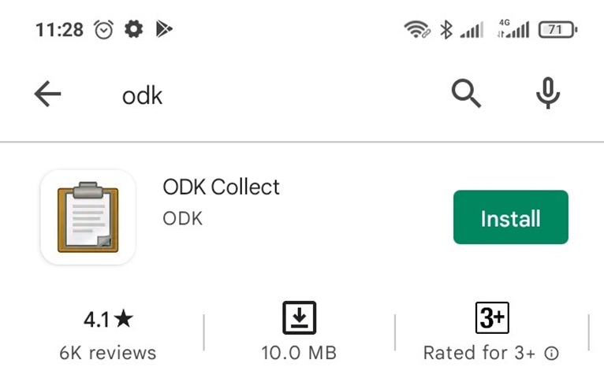
ODK app download and installation
Notes:
Only for android!

Slide 8
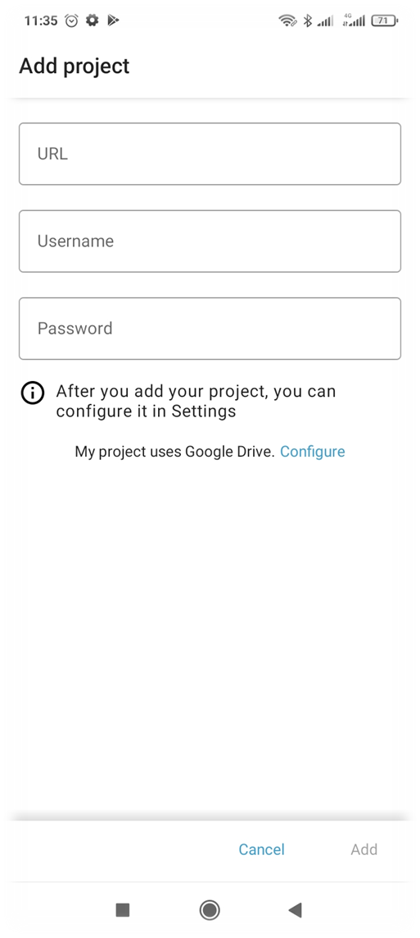
Add project details
Open ODK App, click on “Manually enter project details”.
Add project details as follows
  Enter URL as: https://odk.ona.io
  Enter the username you created in step 2 above
  Enter the password you created in step 2 above
  Click “Add”
Notes:
Please adjust the following settings for data collection in order to be able to access the forms. Once you have entered the Login Data, it will be saved in your phone for future use.

Slide 9
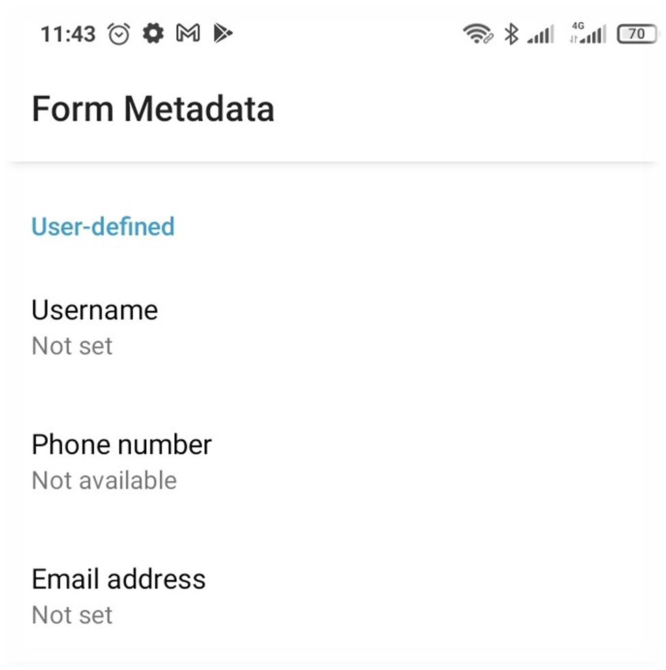
Add Metadata(Identity data)
Please adjust the following settings so we know specific forms that you have sent in.
Notes:
Go to settings>user and device identity>>Form metadata

Slide 10
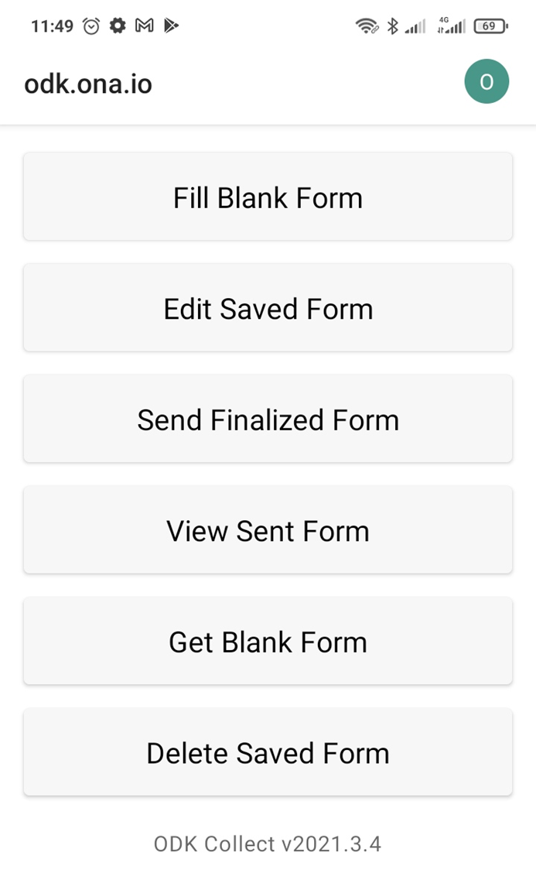
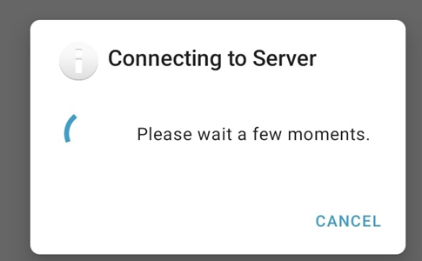
Adding Forms
Before your first data entry with the Smartphone/tablet, you should download all relevant available Profiling Forms on your Smartphone.
At this step an internet connection is required.
Notes:
Tap on Get Blank Forms

Slide 11
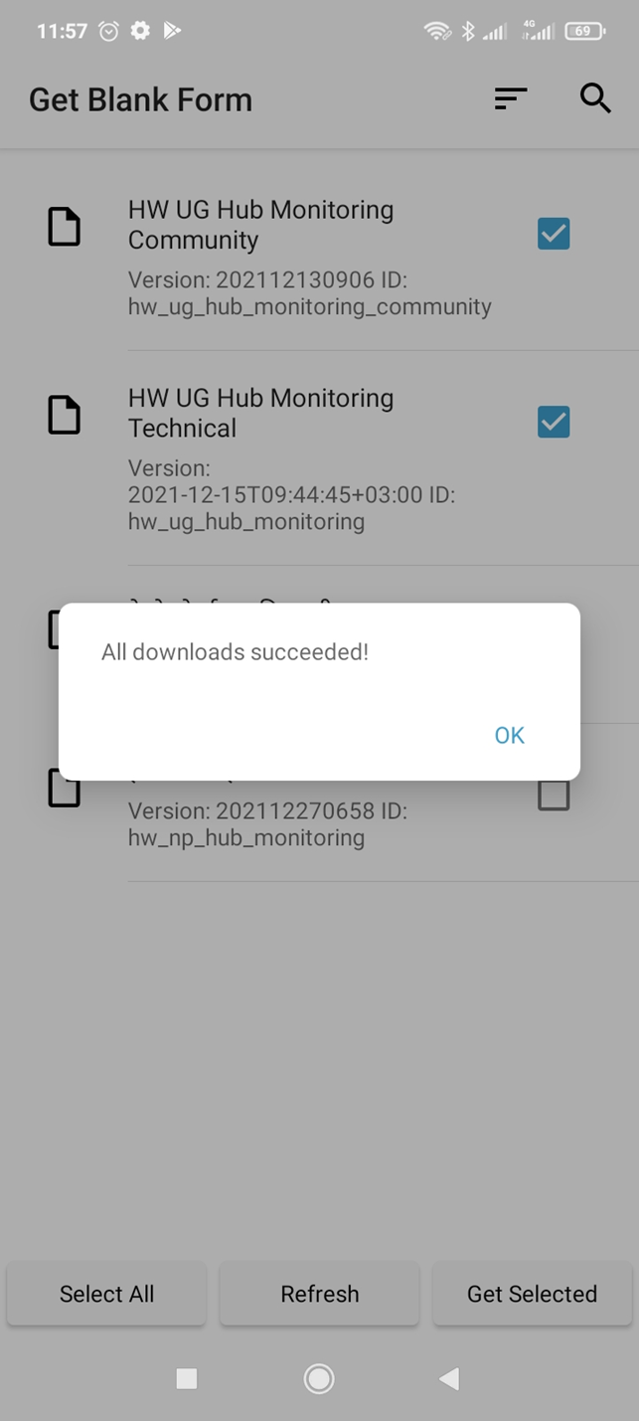
Select relevant forms and tap on Get Selected
Notes:
If you download a new version of the same Smartphone Monitoring Form, it will overwrite the current form and this is a good way to update forms in the event that changes have been made to the original form

Slide 12

Filling Forms
Click on Fill Blank Form to access and fill downloaded forms

Slide 13
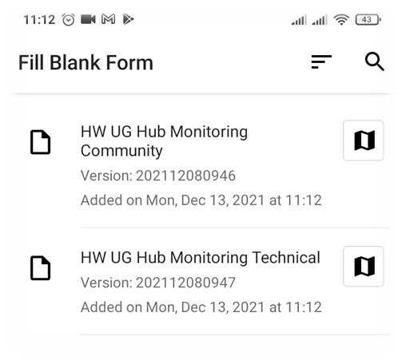
Filling Forms (cont…)
Click on any Form you want to fill

Slide 14
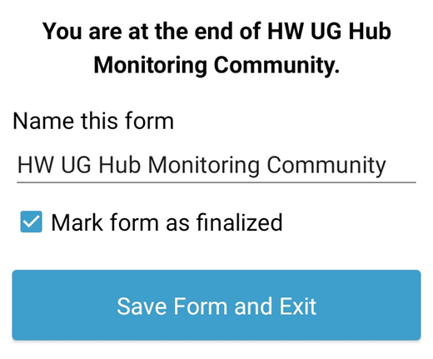
Filling Forms (cont…)
Save the form

Slide 15
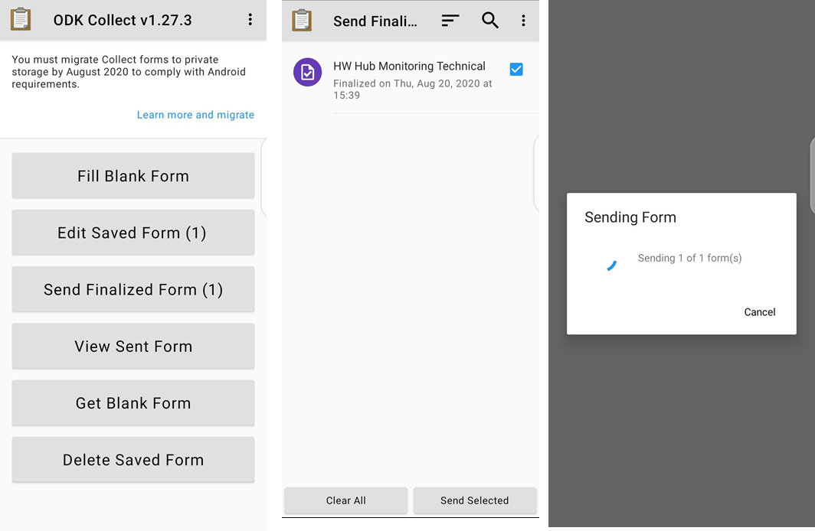
Sending Forms
Click on send Selected
Notes:
NB: You are required to submit data every Wednesday!

Slide 16
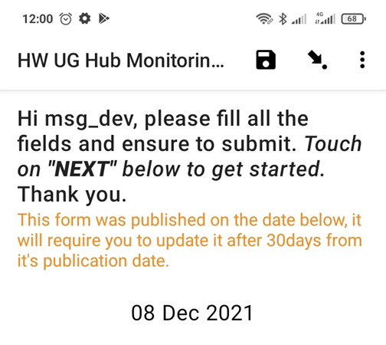
Updating Forms
Click on Get Blank Form

Slide 17
Are U ready 4 Hands On?
Notes:
30min
//ON PC>>OPEN WIRELESS DISPLAY
//ON Phone, under notifications>>click on cast>>add pass code from pc
username: cso2023
pwd:learn2023

Slide 18
Hub metrics
Weekly ODK Data dashboard
myhellohub Data page
Hubs page

Slide 19
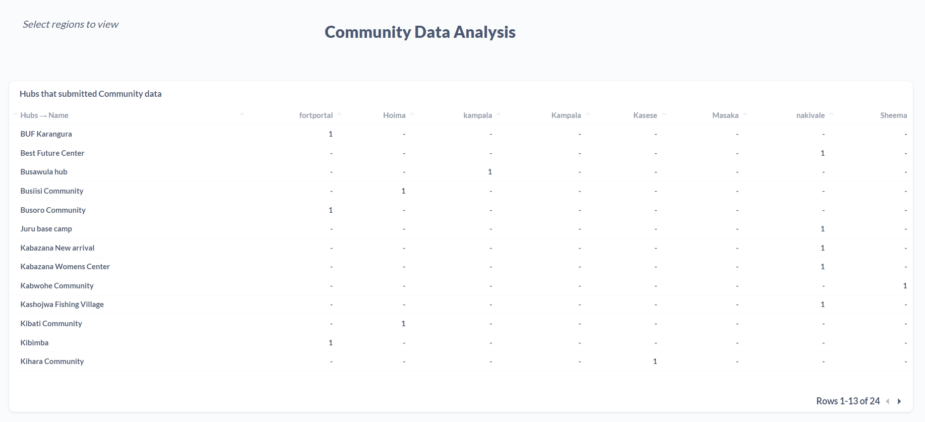
Weekly Hub monitoring Dashboard
Notes:
Show latest live dashboard
Who has access; RO, Engineers, Team at Office and UK

Slide 20
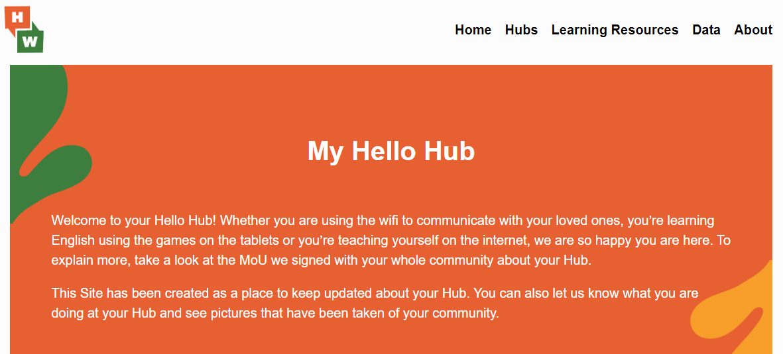
MyHelloHub
URL: https://myhellohub.org
Access: Everyone
Data page
Hubs page
Notes:
Show live data and hubs page
links on hubs page//whatsapp, MoU
Gallery

Slide 21
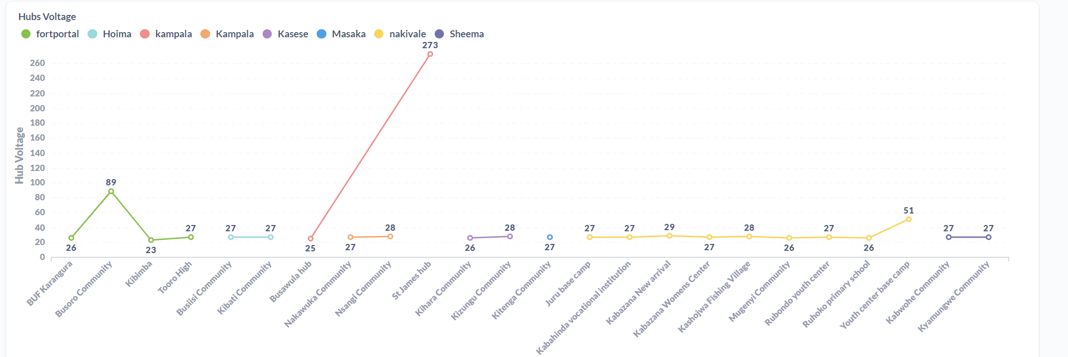
Errors!! - Data Validation
Notes:
wifiman/fast.com/speedtest.net show live tests

Slide 22
Afoyo Matek // Mwebale Nyo // Thank you Awadifo //

Slide 23
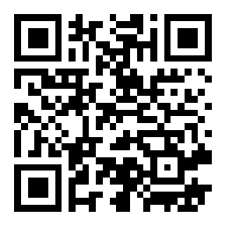

Quiz, Questions & Answers

